Slide 1
Online E-voting System using web development
TS- WEB/CC/AI TRACK CAPSTONE PROJECT
Presented By:
1. Kota Lahari (s170284)
2. Kothapalli Yamini (s170547)
3.Kunche Pavani (s170492)
4.Tadi Jyothsna (s170647)
Guided By: Lipika sharma madam

Slide 2
OUTLINE
Abstract
Problem Statement
Aims , Objective & Proposed Solution
System Design
System Development Approach(Technology Used)
Algorithm & Deployment
Conclusion
References

Slide 3
Abstract
The electronic voting has emerged over time as a replacement to the paper-based voting to reduce the redundancies and inconsistencies . The historical perspective presented in the last two decades suggests that it has not been so successful due to the security and privacy ,flaws observed overtime. We suggested a full stack application by using effective Hashing technique(md5) to ensure the security of the data.The additional feature of the model is that the voter can confirm if his/her vote has gone to correct candidate/party. In this model a person can also vote from outside of his/her allotted position or from his/her preferred location. In the proposed system the tallying of the votes will be done automatically, thus saving a huge time and enabling Election Controller to announce the result within a very short period. It also avoids the process of physical touching or visiting any places and so in the time of remote areas too it will be more helpful to conduct elections. The system deals with the online voting and its details. Allows the user to vote for the candidate online. Can get the details of the candidate and voter as well. Without the wastage of time the citizen can vote the respective candidate. In present existing system we are using ballot paper and counting the number of votes, it takes the lot of time to for the existing process, to overcome the drawbacks in the existing system this particular system was proposed to mark our work much easier and to reduce wastage of time. And more over we doesn’t gets the accurate results in the present existing system. So there is a need for Online Voting Systems.

Slide 4
Problem Statement
The main objective of the project is to develop a web application for Online-voting System. The main points of the project objectives are:
To provide security and make people easily to cast votes and make use their valuable vote to elect their desired representatives.
To develop a user friendly and effective system.
That is to develop a web application where one person can vote only once compared to paper based voting system and also it reduces the cost for conducting elections

Slide 5
Proposed Solution
The system has been designed to support a voting application in the real world environment taking into account specific requirements such as privacy, eligibility, convenience, receipt freeness and verifiability.
The proposed system aims to achieve secure digital voting without compromising its usability. Within this context, the system is designed using a web-based interface to facilitate user engagement with measures such as finger printing to protect against double voting.
With a clear need to administer the voters, constituencies and candidates for constituencies, a user-friendly administrator interface is implemented to enable ease of access.
Furthermore, the system allows all voters equal rights of participation and develops a fair and healthy competition among all the candidates while keeping the anonymity of the voters preserved.

Slide 6
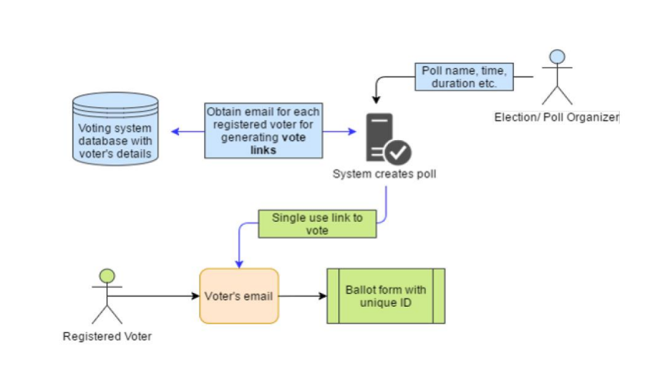
System Architecture
Step By Step Process In My Project

Slide 7
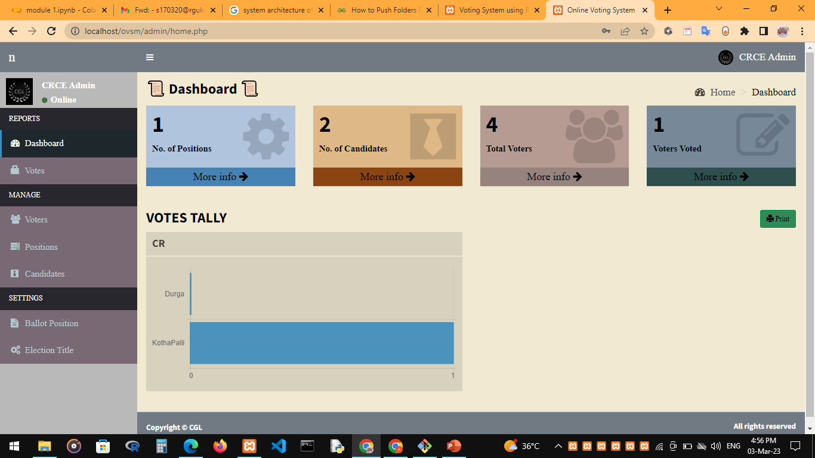
System Deployment Approach
Output:

Slide 8
Conclusion
To overcome all the shortcomings in the present voting System, we came up with the Modern Technology of Hashing i.e. E-Voting System using Hashing Technique. By using this modern technology, following things can be Achieved:-Cheap. Accurate and Fast voting System.
Faith of People on the voting System is Increased therefore, many People Come Forward for Voting, thereby Increasing the Percentage of People Voted .The Pen and Paper Election is Eradicated thereby creating Accuracy in the Voting System . Everybody prefers Time , Cost Efficient Systems so this E-Voting System using Hashing is apt for Transparent Democracy . Ethereal Private Block chain allows hundreds and hundreds of Transactions in a second . For Countries with Greater Population , some additional Technology should be added in this E-Voting System using Hashing in Block chain to avoid Errors. This is the main reason behind this system to present an idea of implementation of in the E-voting system.

Slide 9
References
S.No. | Author & Year | Title of the Reference Paper | Publisher | Analysis
1 | Uzma zafar and Zarina Shukur | Hashing-based e-Voting System |  | Hashing algorithms and methods.
2 | Basit shahzad And shown croft | Trustworthy Electronic Voting Using Adjusted Hashing Technology |  | This research has proposed a framework based on the adjustable MD5 that can apprehend the problems in the polling process, selection of the suitable hash algorithm, selection of adjustments in the hashing, process of voting data management, and the security and authentication of the voting process. The power of hashing has been used adjustably to fit into the dynamics of the electronic voting process.

Slide 10
THANK YOU

